Slide 1
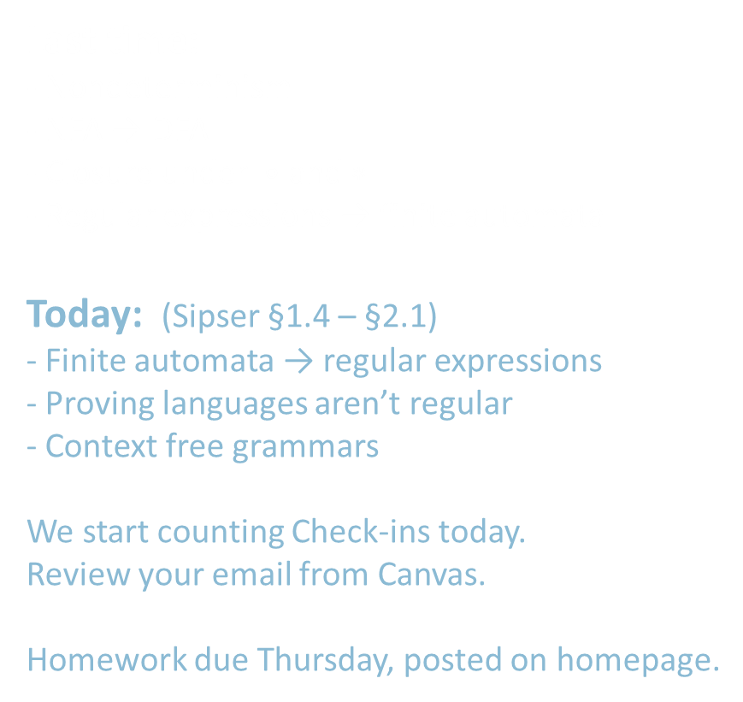
18.404/6.840 Lecture 3
Last time:
- Nondeterminism
- NFA → DFA
- Closure under $∘$ and $∗$
- Regular expressions → finite automata
Today: (Sipser §1.4 – §2.1)
- Finite automata → regular expressions
- Proving languages aren’t regular
- Context free grammars
We start counting Check-ins today.
Review your email from Canvas.
Homework due Thursday, posted on homepage.

Slide 2







DFAs $→$Regular Expressions
Recall Theorem: If $R$ is a regular expressipn and $A=L\left(R\right)$ then $A$ is regular
Proof: Conversion $R$ $→$NFA $M$ $→$ DFA $M′$
$$M$$
Regular expression $R$
Finite automaton
Recall: we did ${\left(\text{a}∪\text{ab}\right)}^{∗}$ as an example
Today’s Theorem: If $A$ is regular then $A=L\left(R\right)$ for some regular expr $R$
Proof: Give conversion DFA $M$ $→$ $R$
WAIT! Need new concept first.

Slide 3










Generalized NFA
Defn: A Generalized Nondeterministic Finite Automaton (GNFA) is
similar to an NFA, but allows regular expressions as transition labels
$$G1$$
a
$${\text{a}}^{∗}{\text{b}}^{∗}$$
ab
$$q1$$
$$q2$$
b
For convenience we will assume:
- One accept state, separate from the start state
- One arrow from each state to each state, except
a) only exiting the start state
b) only entering the accept state
We can easily modify a GNFA to have this special form.
$$\text{ε}$$
$$∅$$
$$\text{a}∪\text{b}$$
aab
$$q3$$
$$\text{ε}$$
$$q4$$

Slide 4







GNFA $→$Regular Expressions
Lemma: Every GNFA $G$ has an equivalent regular expression $R$
Proof: By induction on the number of states $k$ of $G$
Basis $(k=2)$:
Let $R=r$
Induction step $(k>2)$: Assume Lemma true for $k−1$ states and prove for $k$ states
IDEA: Convert $k$-state GNFA to equivalent $\left(k−1\right)$ -state GNFA
$$G=$$
$$r$$
Remember: $G$ is in special form
GNFA
GNFA
$k$ states
$k−1$ states

Slide 5











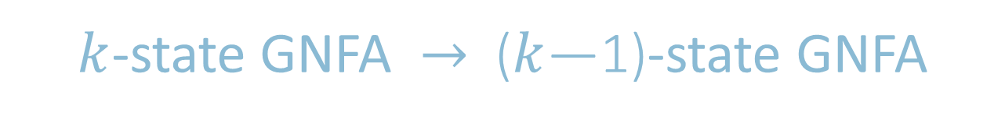




$k$-state GNFA $→$ ($k$—1)-state GNFA
Check-in 3.1
We just showed how to convert GNFAs to regular expressions but our goal was to show that how to convert DFAs to
regular expressions. How do we finish our goal?
Show how to convert DFAs to GNFAs
Show how to convert GNFAs to DFAs
We are already done. DFAs are a type of GNFAs.
$$x$$
$$r_{2}$$
$$x$$
$$r_{1}$$
$$r_{3}$$
Pick any state $x$ except
the start and accept states.
Remove $x$.
Repair the damage by recovering all paths that went through $x$.
Make the indicated change for each pair of states $q_{i}, q_{j}$ .
$$q_{i}$$
$$q_{j}$$
$$q_{i}$$
$$q_{j}$$
$$r_{4}$$
$$r_{1}{\left(r_{2}\right)}^{∗}r_{3}∪r_{4}$$
$k$ states
$k−1$ states
Thus DFAs and regular expressions are equivalent.
Check-in 3.1

Slide 6
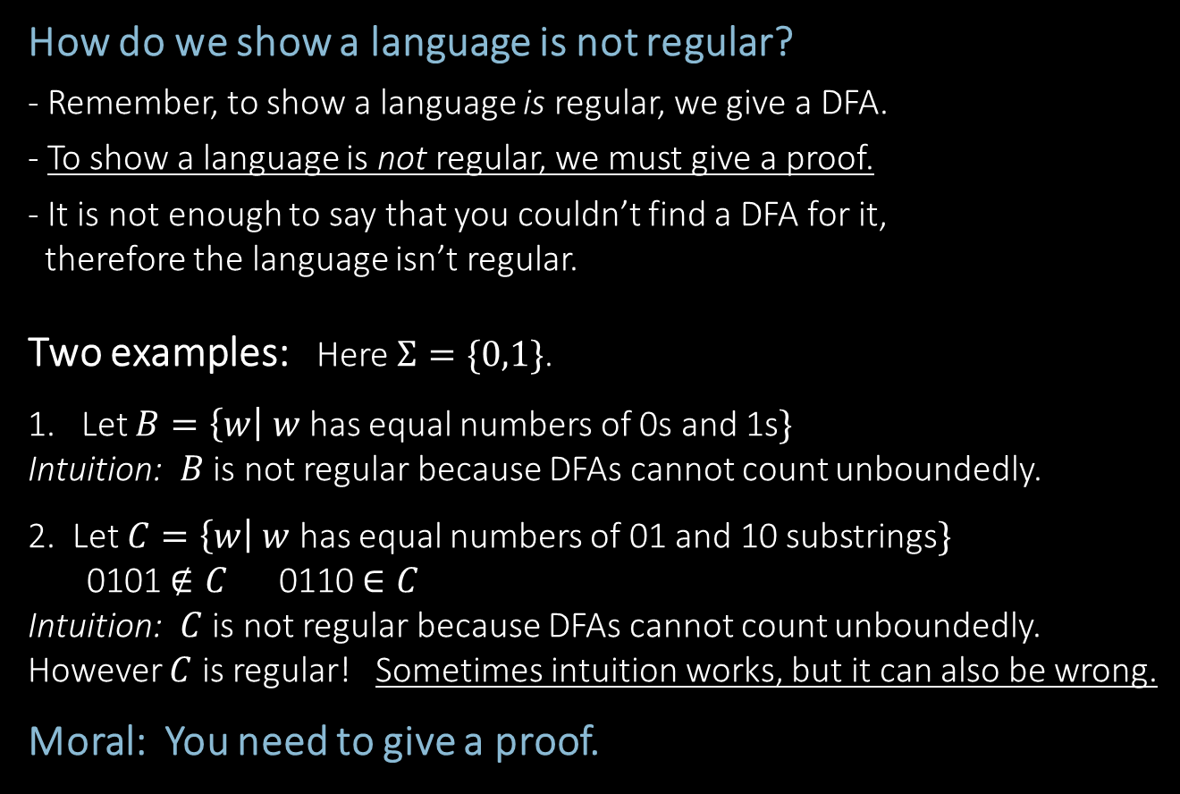
Non-Regular Languages
How do we show a language is not regular?
- Remember, to show a language is regular, we give a DFA.
- To show a language is not regular, we must give a proof.
- It is not enough to say that you couldn’t find a DFA for it,
therefore the language isn’t regular.
Two examples: Here $Σ=\{0,1\}$.
1. Let $B=\left\{w\right| w$ has equal numbers of 0s and 1s$\}$
Intuition: $B$ is not regular because DFAs cannot count unboundedly.
2. Let $C=\left\{w\right| w$ has equal numbers of 01 and 10 substrings$\}$
0101 $∉C$ 0110 $∈C$
Intuition: $C$ is not regular because DFAs cannot count unboundedly.
However $C$ is regular! Sometimes intuition works, but it can also be wrong.
Moral: You need to give a proof.
]
]
]
]
]

Slide 7


Slide 8







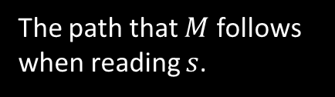
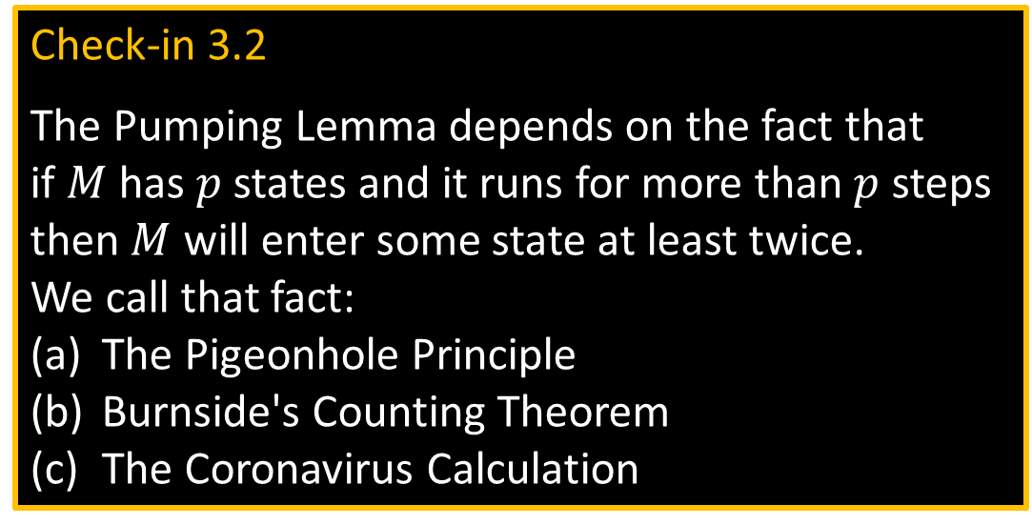
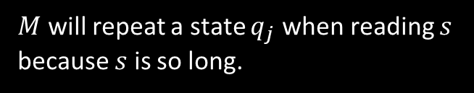













Method for Proving Non-regularity
Pumping Lemma: For every regular language $A$,
there is a number $p$ (the “pumping length”) such that
if $s∈A$ and $\left|s\right|≥p$ then $s=xyz$ where
1) $xy^{i}z∈A$ for all $i≥0$ $y^{i}=yy⋯y$
2) $y≠\text{ε}$
3) $\left|xy\right|≤p$
Informally: $A$ is regular → every long string in $A$ can be pumped and the result stays in $A$.
Proof: Let DFA $M$ recognize $A$. Let $p$ be the number of states in $M$. Pick $s∈A$ where $\left|s\right|≥p$.
}
$$i$$
Check-in 3.2
The Pumping Lemma depends on the fact that
if $M$ has $p$ states and it runs for more than $p$ steps then $M$ will enter some state at least twice.
We call that fact:
The Pigeonhole Principle
Burnside's Counting Theorem
The Coronavirus Calculation
$$s=$$
$$x$$
$$y$$
$$z$$
$$M$$
$$y$$
$$q_{j}$$
$$q_{j}$$
$$q_{j}$$
The path that $M$ follows when reading $s$.
$M$ will repeat a state $q_{j}$ when reading $s$
because $s$ is so long.
$$x$$
$$z$$
$$x$$
$$y$$
$$y$$
$$z$$
$$q_{j}$$
$$q_{j}$$
$$q_{j}$$
is also accepted
Check-in 3.2

Slide 9

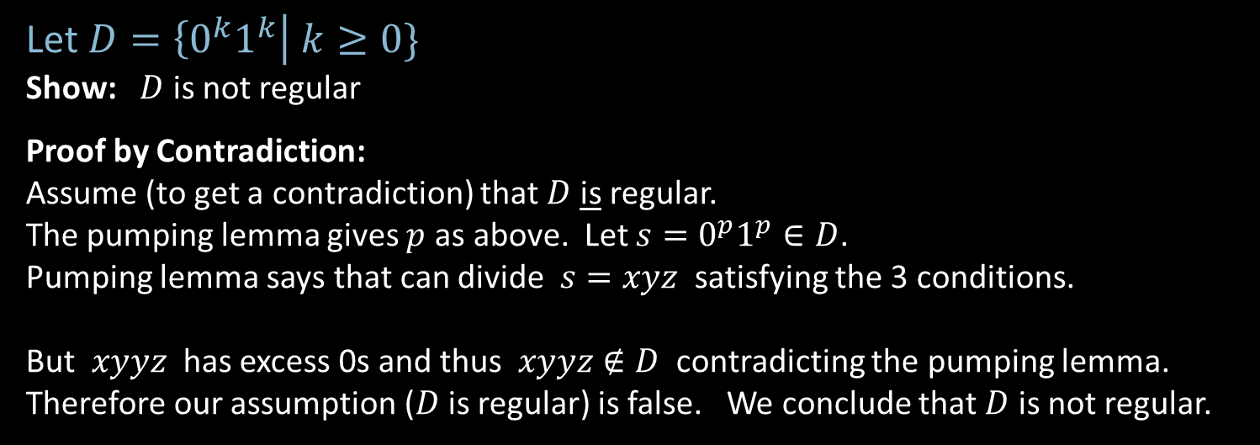






Example 1 of Proving Non-regularity
Pumping Lemma: For every regular language $A$, there is a $p$
such that if $s∈A$ and $\left|s\right|≥p$ then $s=xyz$ where
1) $xy^{i}z∈A$ for all $i≥0$ $y^{i}=yy⋯y$
2) $y≠\text{ε}$
3) $\left|xy\right|≤p$
Let $D=\left\{0^{k}1^{k}\right| k≥0\}$
Show: $D$ is not regular
Proof by Contradiction:
Assume (to get a contradiction) that $D$ is regular.
The pumping lemma gives $p$ as above. Let $s=0^{p}1^{p}∈D$.
Pumping lemma says that can divide $s=xyz$ satisfying the 3 conditions.
But $xyyz$ has excess 0s and thus $xyyz∉D$ contradicting the pumping lemma.
Therefore our assumption ($D$ is regular) is false. We conclude that $D$ is not regular.
$$s=$$
$$000⋯000111⋯111$$
$$x$$
$$y$$
$$z$$
$$≤p$$

Slide 10









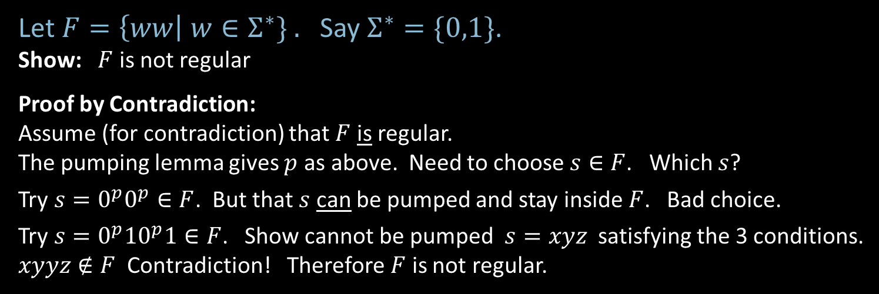



Example 2 of Proving Non-regularity
Pumping Lemma: For every regular language $A$, there is a $p$
such that if $s∈A$ and $\left|s\right|≥p$ then $s=xyz$ where
1) $xy^{i}z∈A$ for all $i≥0$ $y^{i}=yy⋯y$
2) $y≠\text{ε}$
3) $\left|xy\right|≤p$
Let $F=\left\{ww\right| w∈Σ^{∗}\} .$ Say $Σ^{∗}=\{0,1\}$.
Show: $F$ is not regular
Proof by Contradiction:
Assume (for contradiction) that $F$ is regular.
The pumping lemma gives $p$ as above. Need to choose $s∈F$. Which $s$?
Try $s=0^{p}0^{p}∈F$. But that $s$ can be pumped and stay inside $F$. Bad choice.
Try $s=0^{p}{10}^{p}1∈F$. Show cannot be pumped $s=xyz$ satisfying the 3 conditions.
$xyyz∉F$ Contradiction! Therefore $F$ is not regular.
$$s=$$
$$000⋯000000⋯000$$
$$x$$
$$y$$
$$z$$
$$≤p$$
$$y=00$$
$$s=$$
$$000⋯001000⋯001$$
$$x$$
$$y$$
$$z$$
$$≤p$$

Slide 11
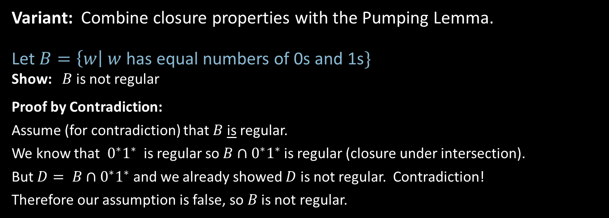
Example 3 of Proving Non-regularity
Variant: Combine closure properties with the Pumping Lemma.
Let $B=\left\{w\right| w$ has equal numbers of 0s and 1s$\}$
Show: $B$ is not regular
Proof by Contradiction:
Assume (for contradiction) that $B$ is regular.
We know that $0^{∗}1^{∗}$ is regular so $B∩0^{∗}1^{∗}$ is regular (closure under intersection).
But $D= B∩0^{∗}1^{∗}$ and we already showed $D$ is not regular. Contradiction!
Therefore our assumption is false, so $B$ is not regular.

Slide 12






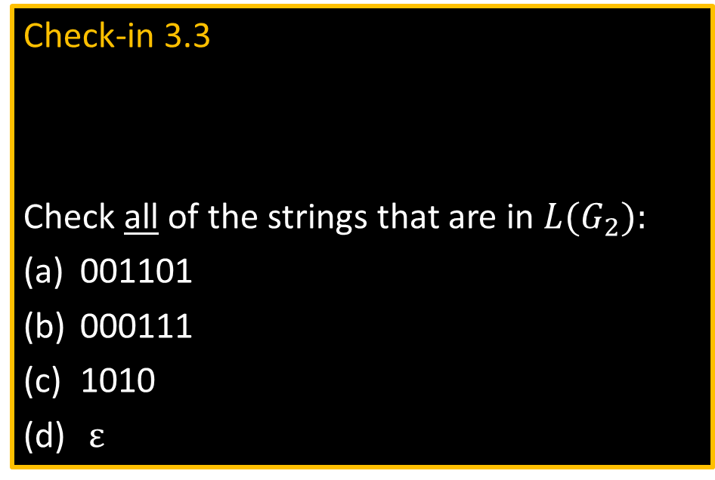




Context Free Grammars
$$G_{1}$$
}
S $→$ 0S1
S $→$ R
R $→$ $ε$
(Substitution) Rules
In $G_{1}$:
Check-in 3.3
Check all of the strings that are in $L(G_{2}):$
001101
000111
1010
$ε$
Rule: Variable $→$ string of variables and terminals
Variables: Symbols appearing on left-hand side of rule
Terminals: Symbols appearing only on right-hand s$ide$
Start Variable: Top left symbol
Grammars generate strings
Write down start variable
Replace any variable according to a rule
Repeat until only terminals remain
Result is the generated string
$L(G)$ is the language of all generated strings.
3 rules
R,S
0,1
S
$$G_{2}$$
S $→$ RR
R $→$ 0R1
R $→$ $ε$
Example of $G_{1}$ generating a string
Tree of
substitutions
S
0S1
0S1
R
$$ε$$
S
0S1
00S11
00R11
0011
Resulting
string
$$∈L\left(G_{1}\right)$$
$$L\left(G_{1}\right)=\left\{0^{k}1^{k}\right| k≥0\}$$
Check-in 3.3

Slide 13
Quick review of today
Conversion of DFAs to regular expressions
Summary: DFAs, NFAs, regular expressions are all equivalent
Proving languages not regular by using the pumping lemma and closure properties
Context Free Grammars

